Slide 1

On Becoming a Leader in Risk Management
Fundamentals of RM
RM System and Process
Leadership in RM
Incident Investigation
RM Tools & Challenges
RM in Industry
People & Org.
Application and Perspectives
ENGG404
Chapter 5.9: Reporting and Correcting Sub-standard Conditions and Sub-standard Practices
1
Notes:
1

Slide 2
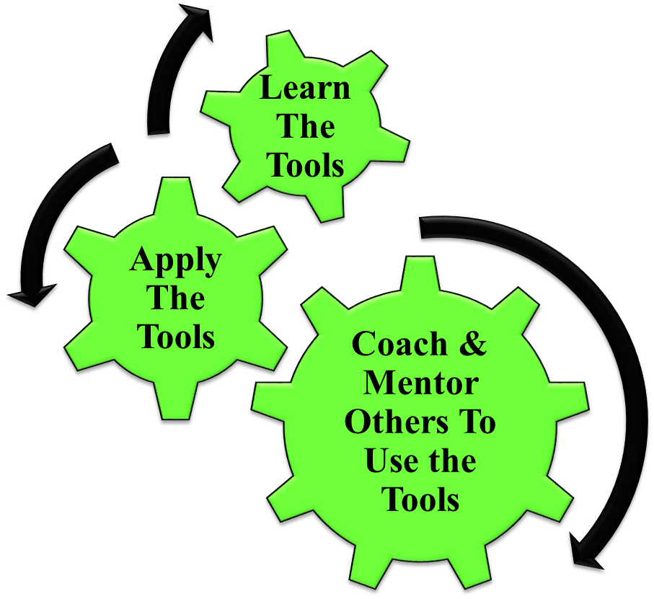
Learning Outcomes:
Apply this Reporting and Correcting method to use, interpret, critique, and create a report of this nature.
Apply this method as a rudimentary skill of leadership to observe, interact, commend or intervene / coach employees in the work-place.
As a reminder, this and all other RM Tools for managing risks can be used to coach and mentor all employees!
Chapter 5.9: Reporting & Correcting Sub-standard Conditions & Sub-standard Practices
2
Notes:
2

Slide 3
Introduction and Definitions :
Sub-standard = unacceptable = at-risk
Practice = work practice = behaviour
Condition = appearance of the area, fitness of the equipment, orderliness of the workspace
Sub-standard condition (SC)
Sub-standard Practice (SP)
Chapter 5.9: Reporting & Correcting Sub-standard Conditions & Sub-standard Practices
3
Notes:
3

Slide 4
Common SCs and SPs in Engineering (full list in handbook):
SCs
Defective tools, equipment or supplies
Inadequate supports or guards
Congestion in the workplace
Inadequate warning systems
Fire and explosion hazards
Poor housekeeping
Hazardous weather conditions
SPs
Employees taking short cuts with safe work procedures
Operating equipment without qualification or authorization
Lack of/or improper use of PPE
Operation equipment at unsafe speeds
Bypass or removal of safety devices
Using defective equipment
4
Notes:
4

Slide 5
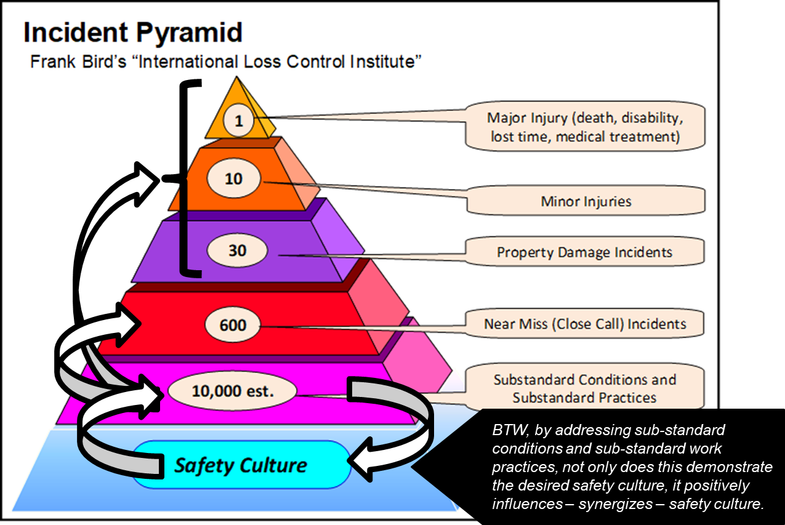
Why Encourage Reporting of SCs and SPs:
What is the relationship between the 4 points below?
Improves safety performance
Influence culture
Address safety concerns
Report SC and SP
Chapter 5.9: Reporting & Correcting Sub-standard Conditions & Sub-standard Practices
5
Notes:
5

Slide 6
The Impact of Addressing SCs and SPs:
Culture will only be improved if SCs and SPs are reported, corrected, and followed up on
Proactive!
Through non-planned inspections and observations in the workplace
Through employee reporting
Chapter 5.9: Reporting & Correcting Sub-standard Conditions & Sub-standard Practices
6
Notes:
6

Slide 7
Reporting and Tracking:
Chapter 5.9: Reporting & Correcting Sub-standard Conditions & Sub-standard Practices
7
Notes:
7

Slide 8
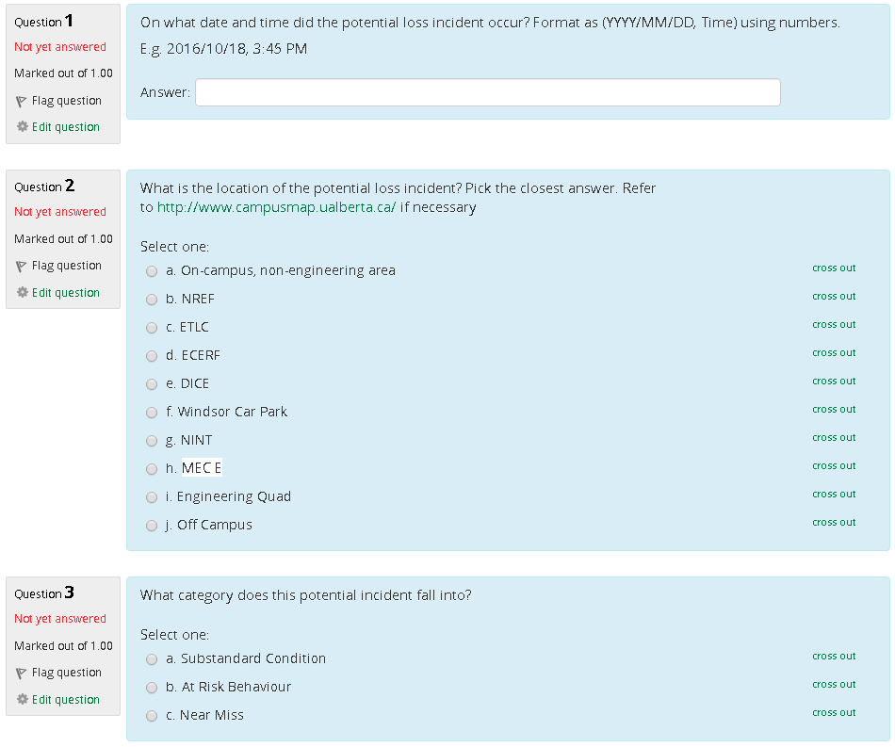
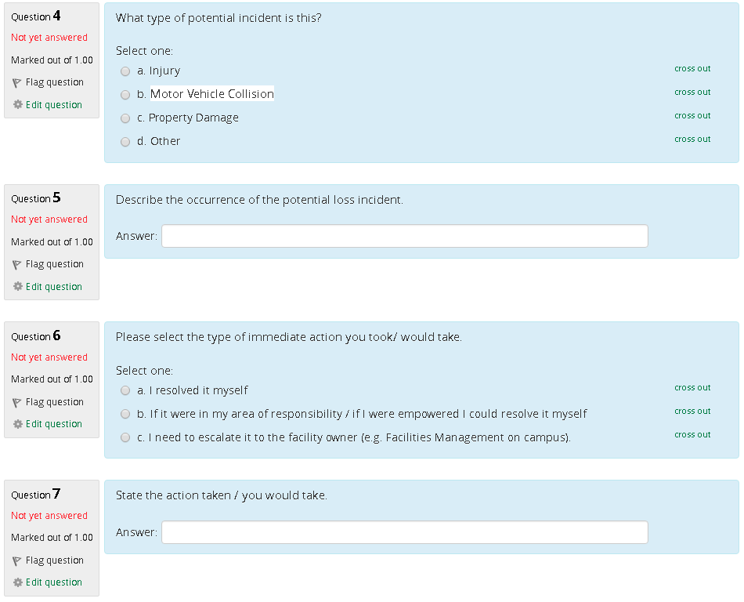
Reporting and Tracking – Using the Tool on eClass:
Chapter 5.9: Reporting & Correcting Sub-standard Conditions & Sub-standard Practices
8
Notes:
8

